Slide 1
Capstone Project-4
Netﬂix Movies and TV Shows Clustering
Team Members :
Abhishek Kumar Hritik Saini

Slide 2
Contents:
Introduction
Problem Statement
Data Description
Dataset Summary
Exploratory Data Analysis
Data Cleaning
Data Pre-processing
ML Model Implementation
K- Means
Cluster Analysis

Slide 3

Introduction:
Netﬂix is a media distribution company. It started with DVD distribution via mail, but has evolved substantially over the course of its existence. Today, Netﬂix is focused on streaming video. Some of its content is licensed, and some of the content is produced in-house.
Netﬂix originally focused on movies, but today television shows are probably the more common format. Netﬂix works on a subscription model, where users get unlimited access to content with a paid subscription.

Slide 4
Problem Statement
This dataset consists of tv shows and movies available on Netflix as of 2019. The dataset is collected from Flixable which is a third-party Netflix search engine.
In 2018, they released an interesting report which shows that the number of TV shows on Netflix has nearly tripled since 2010. The streaming service’s number of movies has decreased by more than 2,000 titles since 2010, while its number of TV shows has nearly tripled. It will be interesting to explore what all other insights can be obtained from the same dataset.
Integrating this dataset with other external datasets such as IMDB ratings, rotten tomatoes can also provide many interesting findings.
In this project, you are required to do
> Exploratory Data Analysis
> Understanding what type content is available in different countries
> Is Netflix has increasingly focusing on TV rather than movies in recent years.
> Clustering similar content by matching text-based features

Slide 5
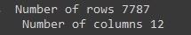
Data Description
This dataset consists of tv shows and movies available on Netﬂix as of 2019. The dataset is collected from Flixable which is a third-party Netﬂix search engine.
Attribute Information
show_id : Unique ID for every Movie / Tv Show
type : Identiﬁer - A Movie or TV Show
title : Title of the Movie / Tv Show
director : Director of the Movie
cast : Actors involved in the movie / show
country : Country where the movie / show was produced
date_added : Date it was added on Netﬂix
release_year : Actual Release Year of the movie / show
rating : TV Rating of the movie / show
duration : Total Duration - in minutes or number of seasons
listed_in : Genre
description: The Summary description

Slide 6
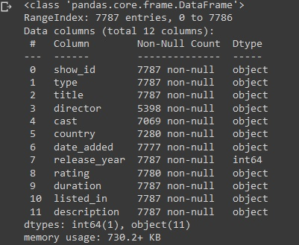
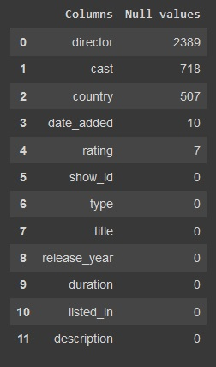
Dataset summary:
The dataset contains 12 columns and 7787 rows.
There also exist some null values in oura data: Percentage of null values in director : 30.68%
Percentage of null values in cast : 9.22% Percentage of null values in country : 6.51% Percentage of null values in date_added : 0.13% Percentage of null values in rating : 0.089%
Since there are very few null values in date_added and rating we will drop them.
Finally we will do some feature engineering to create few new variables:
Compute year_added, month_added and day_added from date_added after converting it into datetime variable.

Slide 7
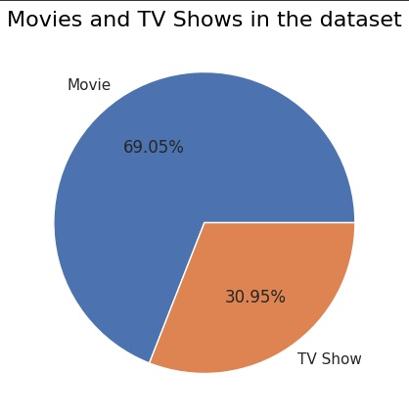
Exploratory Data Analysis:
Type:
69.1% of the content available on Netﬂix are movies; the remaining 30.9% are TV Shows.

Slide 8
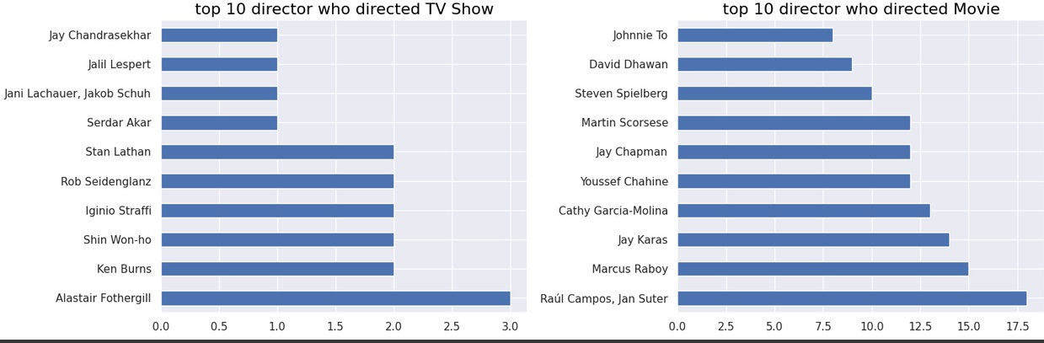
Top 10 Directors
The director Alastair Fothergill has directed three TV shows, which is the highest number of TV shows directed by any director in the dataset.
Raul Campos and Jan Suter have collaborated directed 18 movies, which is the highest number compared to any other director pair in the dataset. Following them are Marcus Raboy, Jay Karas, and Cathy Garcia-Molina.

Slide 9
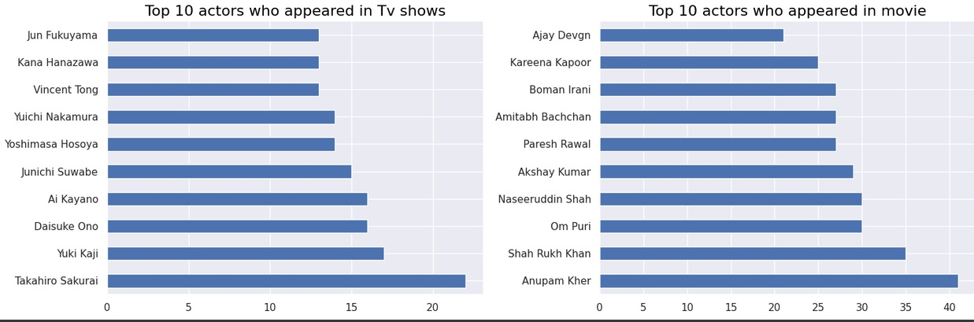
Top 10 Actors
Takahiro Sakurai, Yuki Kaji and Daisuke Ono played highest role in the TV shows.
Anupam Kher, Shahrukh Khan and Om Puri played highest number of role in the movies

Slide 10
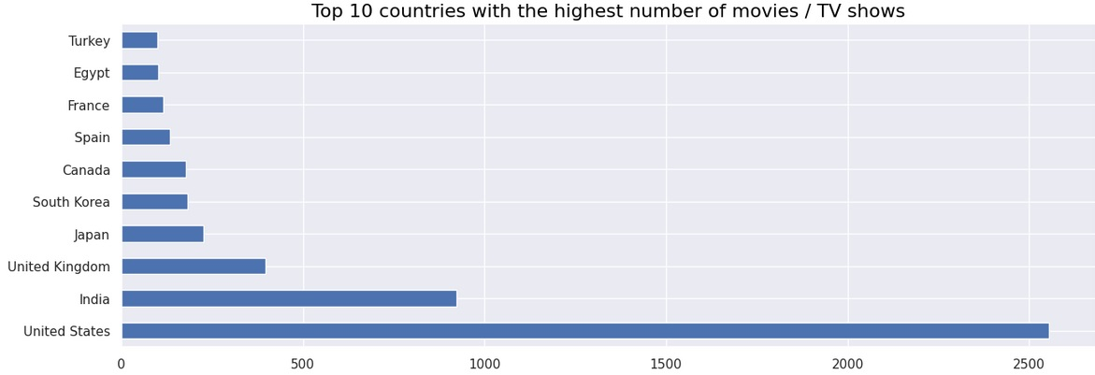
Country:
The majority of the content providers are in the above top-ten countries.
Among which India , USA, and UK create more than half of the TV shows and movies on the platform.

Slide 11
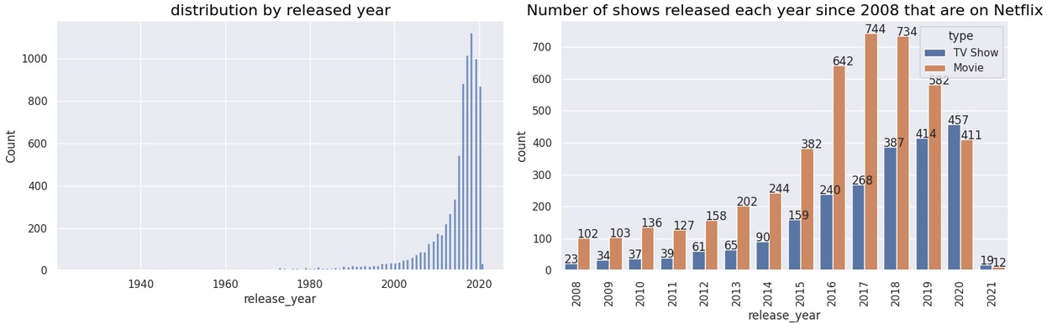
Release_year:
82% of the content available was released between 2010 and 2021.
17.28% of the content available was released before 2010.
Netflix has more new movies and TV shows than old ones.
The company has a consistent focus on adding new shows to its platform.
In 2020, there was a decrease in the number of movies added, but not in the number of TV shows added. This could indicate a shift towards introducing more TV series rather than movies on Netflix.

Slide 12
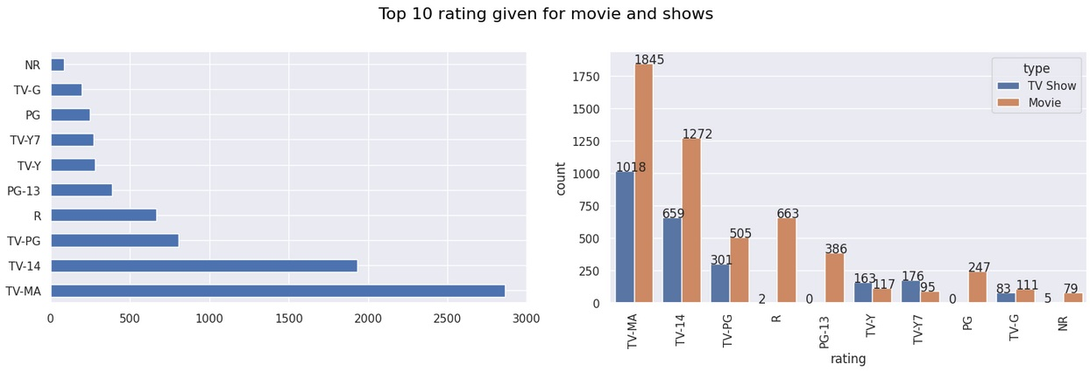
Top 10 Ratings:
Most of the movie and tv shows have rating of TV-MA (Mature Audience) then followed by TV-14 (younger audience).

Slide 13
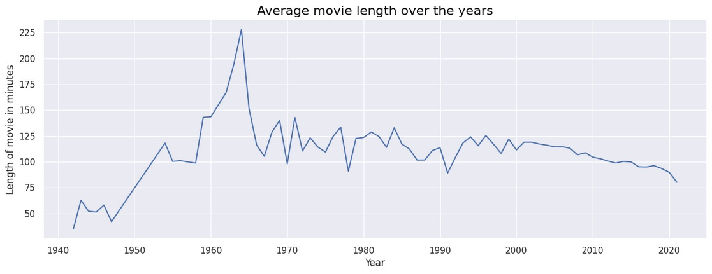
Average Movie Length
Netflix offers a range of movies on its platform, including those from as far back as 1942.
Movies made in the 1940s had a relatively short duration, according to their plots.
On average, movies made in the 1960s are the longest in length.
The average length of movies has been decreasing steadily since the 2000s.

Slide 14
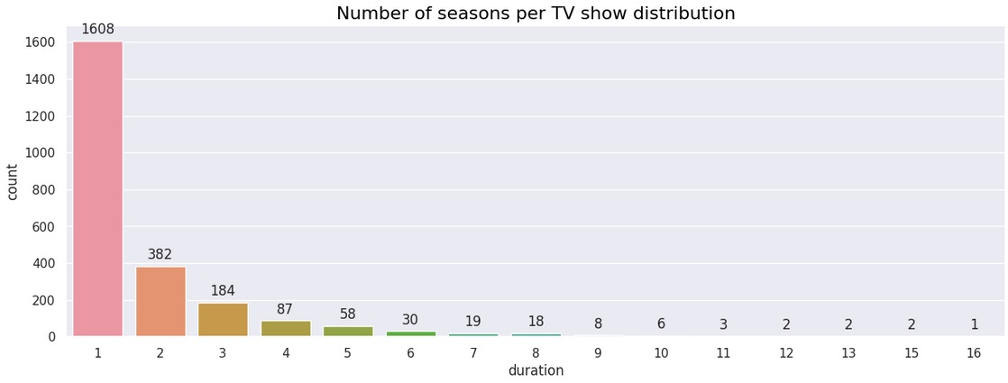
Average TV Show Seasons
The TV series in the dataset have a maximum of 16 seasons, but the majority only have one season.
This could suggest that many of the TV shows are relatively new and additional seasons may be in the works.
There are very few TV shows in the dataset with more than 8 seasons.

Slide 15
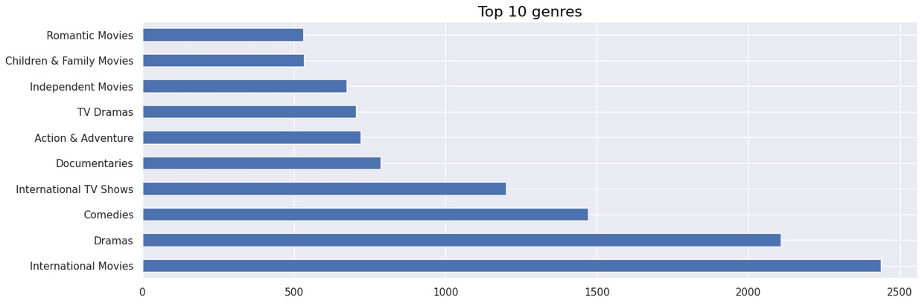
Top 10 Genres
The International movie is the most popular genre followed by dramas and comedies.
Most of the common words present in description column are family, find, life, love, new, world, friend.

Slide 16
Data Cleaning
Removing non-ASCII characters:
Removing stopwords and lower case:
Removing Punctuation:
Stemming:
Tf – idf Vectorization:

Slide 17
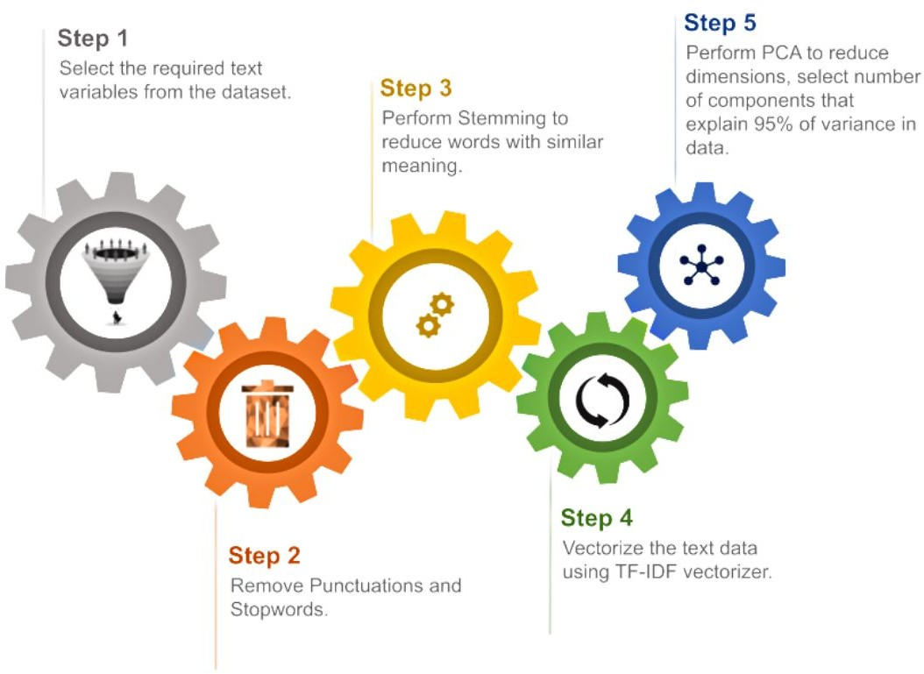
Data Preprocessing.

Slide 18
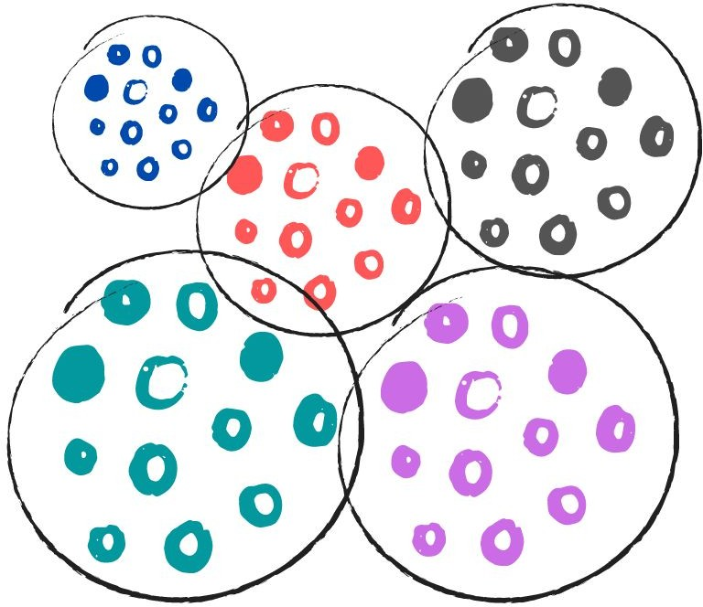
Creating Clusters:
What is clustering?
Clustering is the task of dividing the data points into a number of groups such that data points in the same groups are more similar to other data points in the same group and dissimilar to the data points in other groups. It is basically a collection of objects on the basis of similarity and dissimilarity between them.
How to cluster similar data?
To create clusters we will use the K-Means Clustering; which is an iterative process in which the dataset is grouped into k number of predeﬁned non-overlapping clusters or subgroups, making the inner points of the cluster as similar as possible while trying to keep the clusters at distinct space it allocates the data points to a cluster so that the sum of the squared distance between the clusters centroid and the data point is at a minimum.

Slide 19
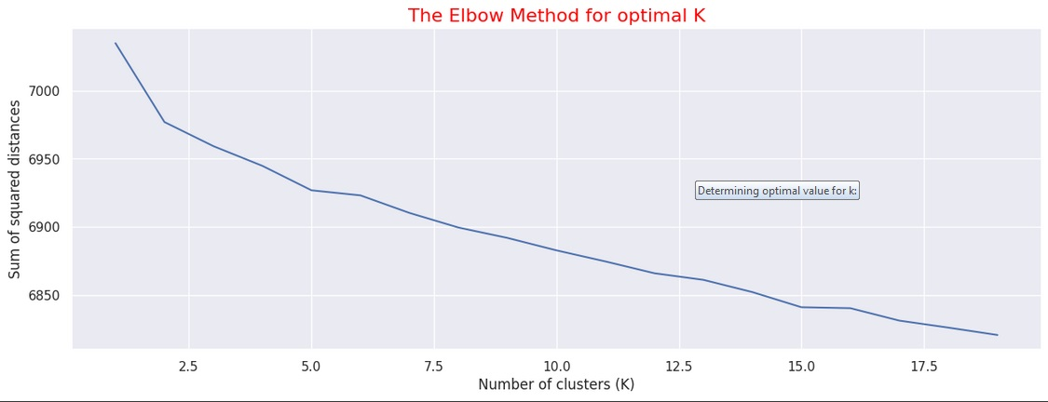
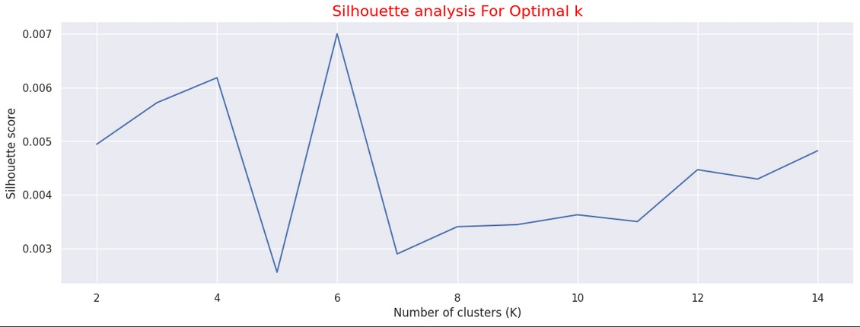
Determining optimal value for k:
Using the Silhouette Score and Elbow Method we select the optimal number of clusters to be 10.

Slide 20
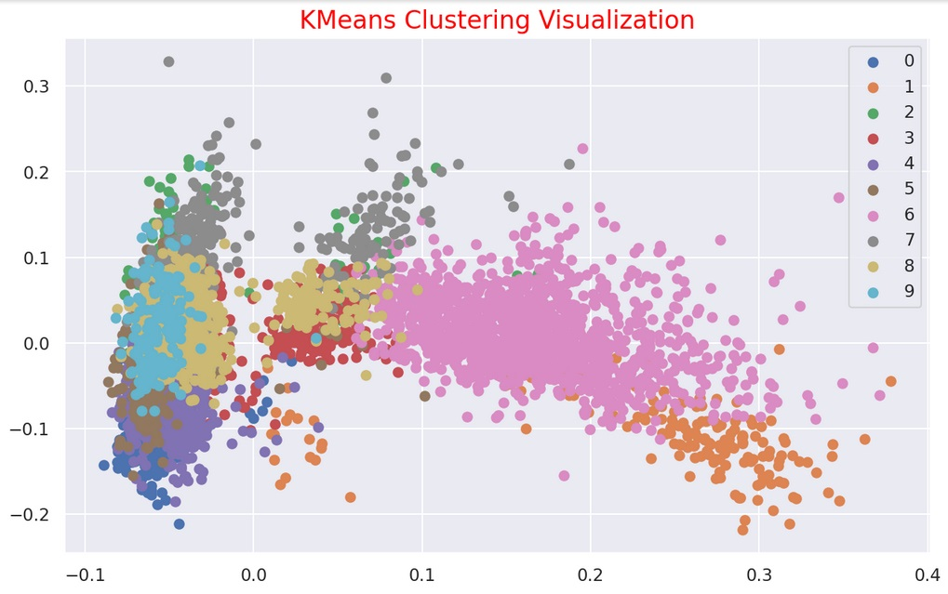
10 Distinct clusters created using kMeans Clustering
The numbers 0 to 9 represent 10-distinct clusters formed by K-means clustering.
Each cluster contains data points similar to those in the same groups but varies from other groups.

Slide 21
K - Means
To process the learning data, the K-means algorithm in data mining starts with a first group of randomly selected centroids, which are used as the beginning points for every cluster, and then performs iterative (repetitive) calculations to optimize the positions of the centroids
It halts creating and optimizing clusters when either:
The centroids have stabilized — there is no change in their values because the clustering has been successful.
The defined number of iterations has been achieved

Slide 22
K-Means Clustering
K-means algorithm is an iterative algorithm that tries to partition the dataset into K pre defined distinct non overlapping subgroups where each data point belongs to only one group.
1. Elbow Curve:
● The Elbow Curve is one of the most popular methods to determine this optimal value of k.
● The elbow curve uses the sum of squared distance (SSE)to choose an ideal value of k based on the distance between the data points and their assigned clusters.
2. Silhouette score :
● Silhouette score is used to evaluate the quality of clusters created using clustering algorithms such as K Means in terms of how well samples are clustered with other samples that are similar to each other.

Slide 23
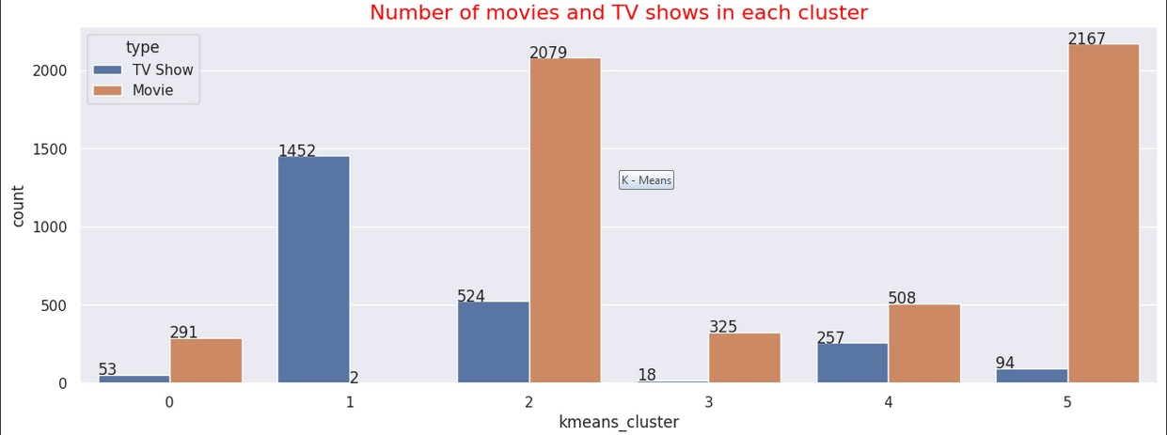
Clusters
Successfully built 6 clusters using the k-means clustering algorithm.

Slide 24
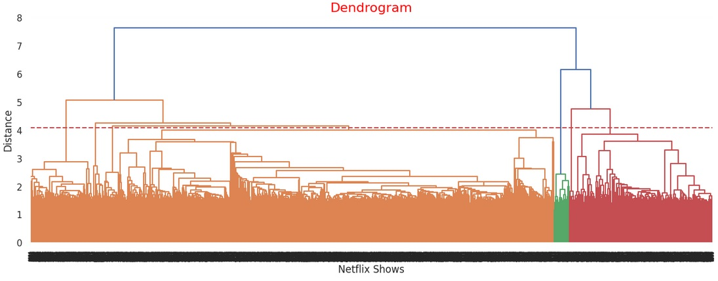
Hierarchical Clusters
The agglomerative (hierarchical) clustering algorithm is employed to construct clusters. This approach involves merging clusters that are similar, starting with each sample as a single-sample cluster, and building a hierarchy of clusters from the bottom up. To determine the optimal number of clusters, a dendrogram can be visualized when using the agglomerative (hierarchical) clustering algorithm.

Slide 25
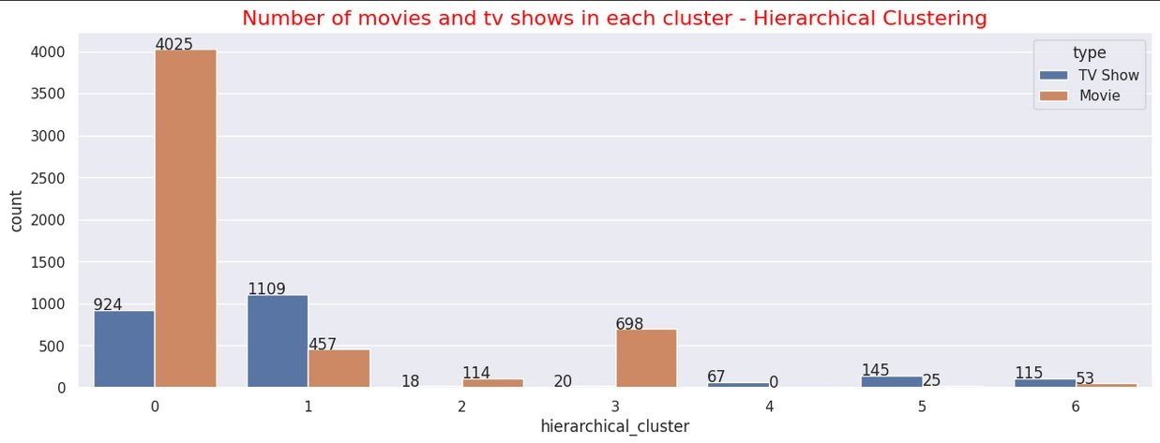
Hierarchical Clusters
The Agglomerative (hierarchical) clustering algorithm was utilized to construct 7 clusters successfully.

Slide 26

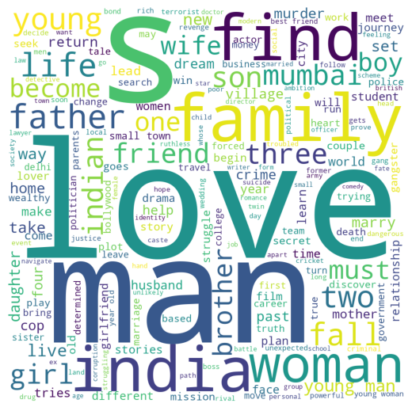


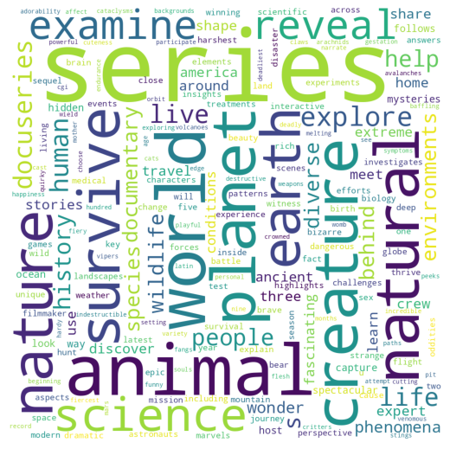
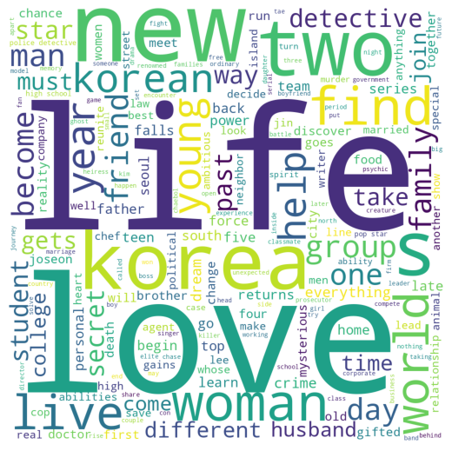

Word Cloud of hierarchical Clusters

Slide 27
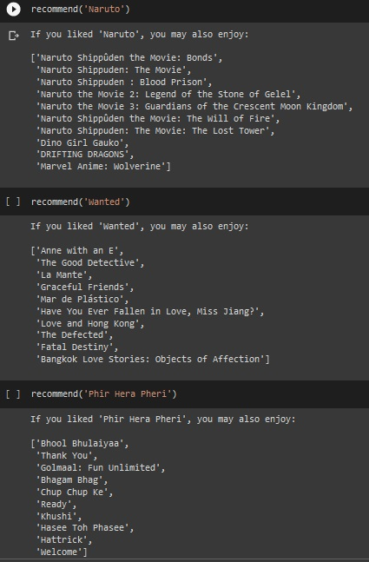
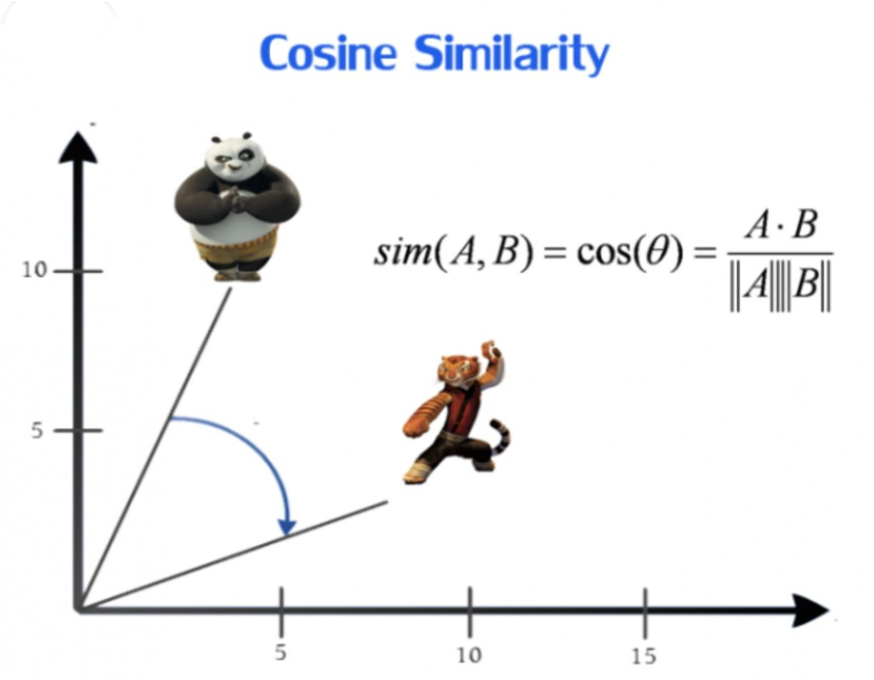
Getting Recommendations:
We obtained recommendations for Movies and Tv- Shows using Cosine similarity.

Slide 28
Conclusions:
The dataset had 7787 records and 11 attributes. I performed exploratory data analysis and handled missing values.
I discovered that Netflix has more movies than TV shows, and the number of shows on the platform is growing rapidly. Most shows are produced in the United States.
I chose to cluster the data based on attributes such as director, cast, country, genre, rating, and description. I tokenized, preprocessed, and vectorized these attributes using TFIDF Vectorizer, resulting in 10,000 attributes.
To reduce dimensionality, I utilized Principal Component Analysis (PCA), with 4,000 components capturing over 80% of variance.
I used K-Means Clustering to build the initial clusters, with the optimal number of clusters being 6 as determined by the elbow method and Silhouette score analysis.
Agglomerative clustering was used to create clusters, with 7 being the optimal number determined by visualizing the dendrogram.
Finally, I developed a content-based recommender system using cosine similarity on the similarity matrix. The recommender system recommends the top 10 shows based on the type of show the user has watched.

Slide 29
Thank you

